Slide 1
Internship Completion Report. ~ 29th May,23 – 28th July,23
~ Rohan Sakkarwal
~ Ankit Kumar
~ Parvesh Kumar Sirmoria

Slide 2
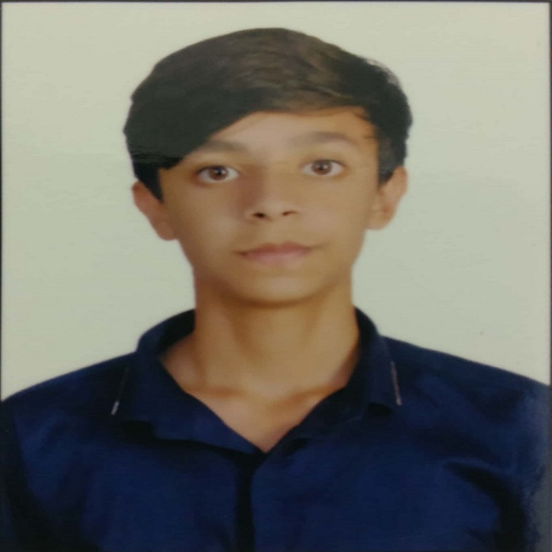
Introduction of Interns
Name: Rohan Sakkarwal Age: 20years
~ 4th year student pursuing Bachelor in Technology in
Computer Engineering from DTU.
~ Internship at Siemens (29th May,23 to 28th July)
~ Good hands in coding and have knowledge about
-> C++, JAVA
-> OOPS , DBMS
-> Web Development
~ Hobbies
-> Sports (National Level player in Basketball)
-> Dance (Won street battles)
-> Orange belt in Taekwondo

Slide 3
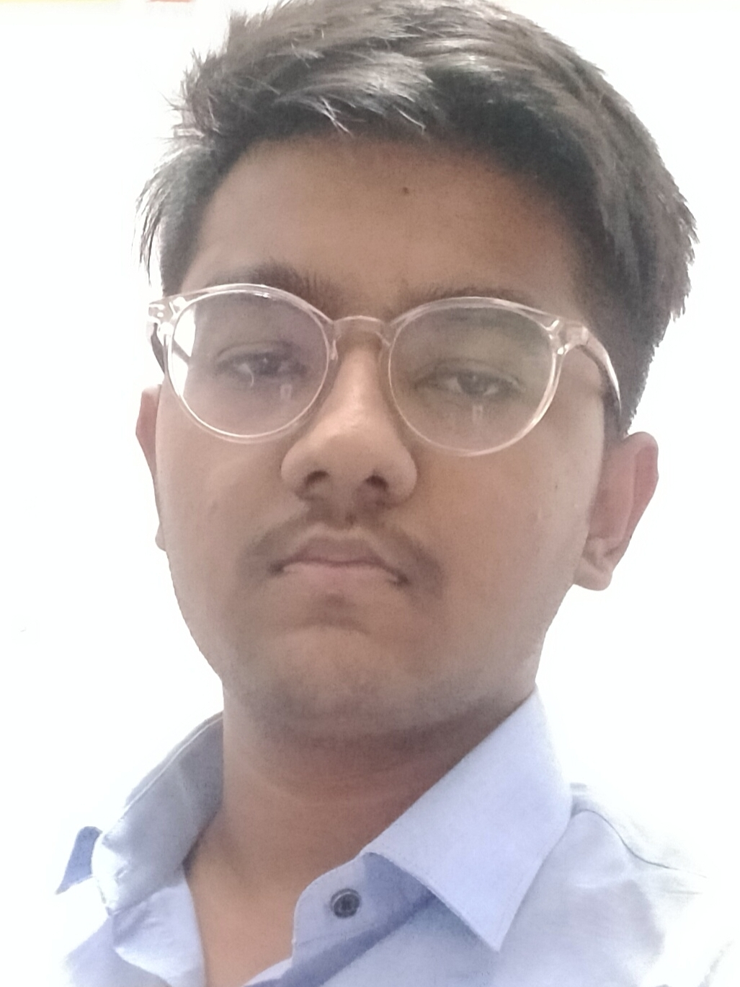
Name: Ankit Kumar Age: 21years
~ 4th year student pursuing Bachelor in Technology in
Information Technology from DTU.
~ Internship at Siemens (29th May,23 to 28th July)
~ Good hands in coding and have knowledge about
-> C++,JAVA
-> ML
-> Web Development
~ Hobbies
-> Reading books
-> Blogging

Slide 4
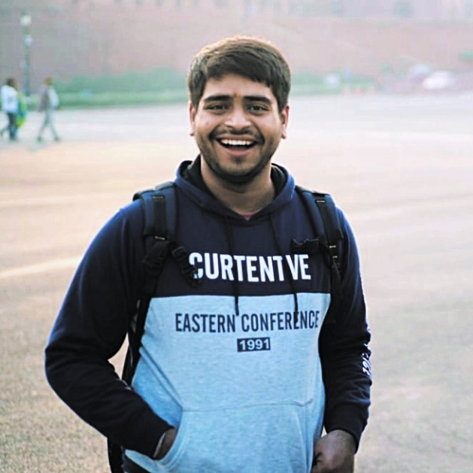
Name : Parvesh Kumar Sirmoria Age : 21
4th year student pursuing Bachelor of Technology in Computer Engineering from DTU.
Internship Period: 29th May,23 to 28th July,23
Likes to do Competitive Programming and have interest in fields like Cyber Forensics, Malware detection and Ethical Hacking.
Hobbies :
Likes to play Chess and Cricket.
Used to participate in singing competitions.
Loves to write poems.

Slide 5
What have we done in these 2 months?
1st Month
-> Overview about Energy IP.
-> Strengthen our technical aspects like: -
JAVA
OOPS
Spring boot
Apache camel
2nd Month
Started working on the project

Slide 6

PROJECT INTRODUCTION
Project Name: Non-Technical Losses Analytics project
~ Aims to leverage
advanced data analytics,
machine learning techniques, and
statistical modeling
to analyze vast amounts of data collected from various sources.

Slide 7
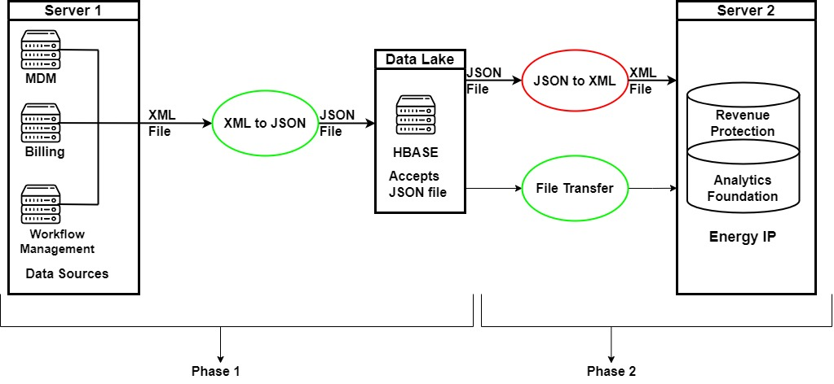

Slide 8

PROJECT DESCRIPTION

Slide 9

CONTENTS
PROJECT
OVERVIEW
PROJECT
CONTENT
Challenges
Faced
01
02
03

Slide 10

PROJECT
OVERVIEW
01

Slide 11
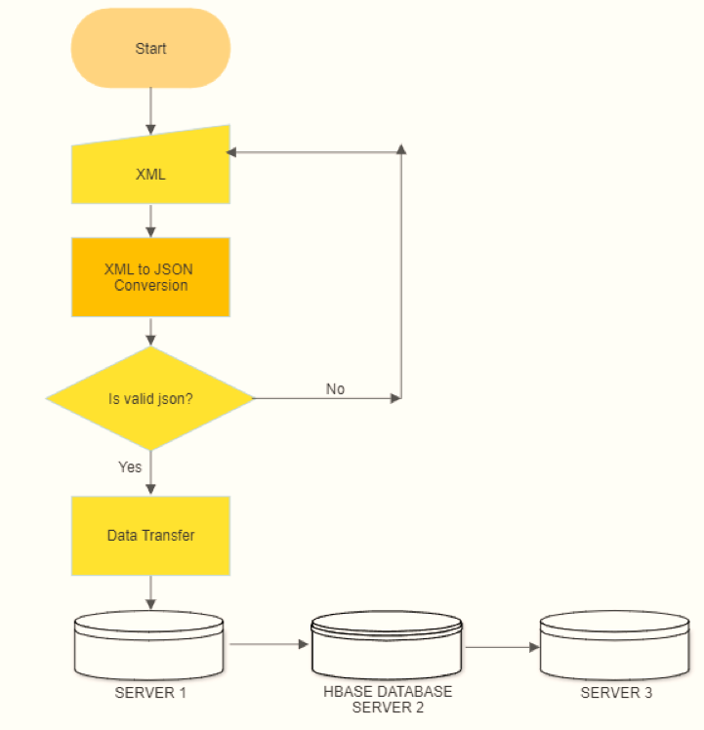
FLOW CHART

Slide 12

PROJECT
DEVELOPMENT REQUIREMENTS
JAVA
Primary language of the project.
Eclipse IDE
JAVA IDE required for developing java application.
Requirement
Maven Dependencies
Dynamic dependencies for proper export of project.
Apache Camel
Required for trasferring files via routes.
Git
For version control of the project.

Slide 13
PROJECT
DETAILED OVERVIEW
XML to JSON
Converting our sample input xml file to json
Validating JSON
Checking all the attributes of json is correct or not.
Data Transfer
Transferring files to servers via Apache Camel.

Slide 14
PROJECT
02
CONTENT

Slide 15
PROJECT
CONTENT
XMLmap.java
Validate.java
Java file to map our Xml file to json.
Checking if we are getting all the attributes.
Output buffer
filetransferviacamel
Storing files to be sent in output folder.
Sending files through routes of Apache Camel.

Slide 16
PROJECT
CODE FLOW
Xml file
Xml Doc obj
XML String
JSON obj
File Sent
Apache Camel
Connecting to VPN
JSON File
Xml to json
Output file
Apache Camel

Slide 17
03
CHALLENGES
FACED

Slide 18


Strengths
Weaknesses
Opportunities
Treats
JAVA
Apache Camel
System Admin
Knowledge
IDE
Connecting to server
Git control
Linux
S
W
O
T

Slide 19
CONCLUSION
Setting up the servers and installation of HBase.
kn
Conversion of an XML file to JSON and validating the JSON file.
Finally transferring the JSON file to servers via Apache camel.

Slide 20
FUTURE SCOPE
Implementation of code to transfer file to server 2 and convert it from JSON to XML in order to do further analysis.
The data can be used for further data analytics, machine learning techniques and static modelling.

Slide 21

SKILLS LEARNED
PROJECT MANAGEMENT
As an intern, we were given an opportunity to work on a project. This experience helped us improve our project management skills such as planning, prioritizing and executing.
EXPERIENCE
Through this internship, we have acquired valuable experience and developed new skills.

Slide 22



THANK
You

